Slide 1
Neural Style Transfer
Fabian Weiland, Mark Kim, Satvik Verma

Slide 2
Satvik part

Slide 3

Hyper Parameters
weight for content loss α
weight for style loss β
choose content layer
choose style layers
number of optimisation steps (number of iterations)

Slide 4
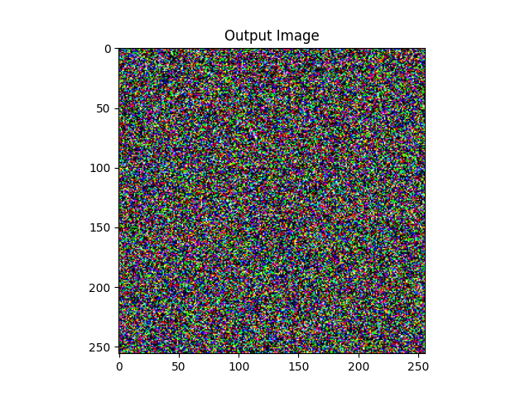

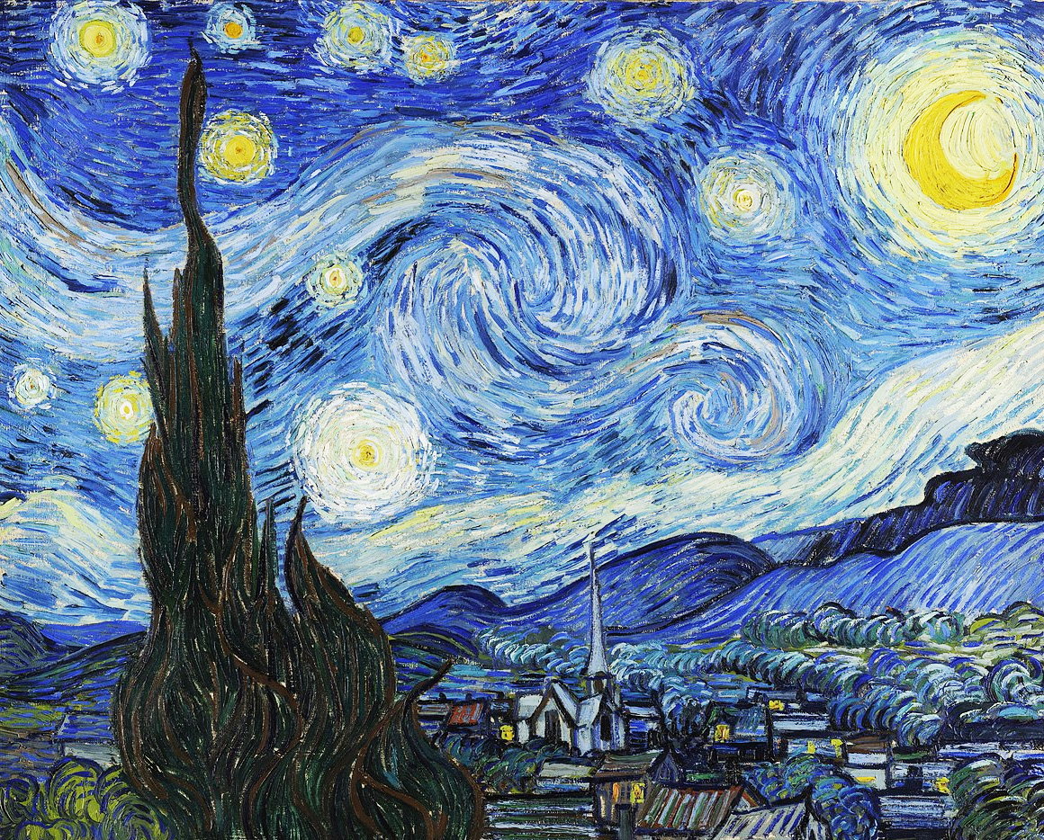
content image
First Option
style Image
start image is noise image

Slide 5
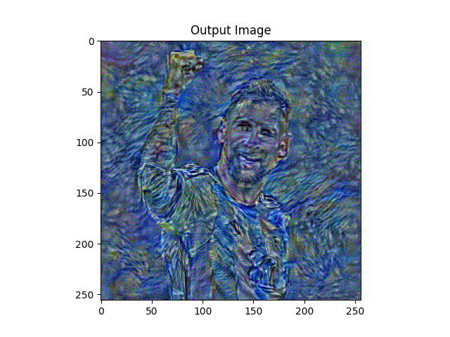
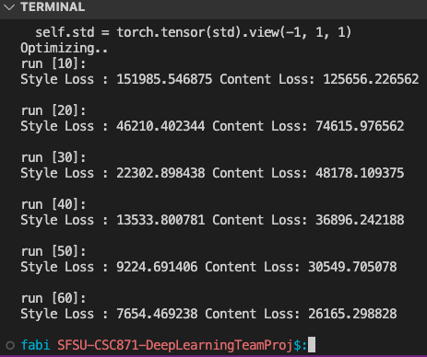
content_loss_weight = 1000
style_loss_weight = 10,000,000
content_layer = 8
style_layers = 2,3,4,5,6
num_steps = 50

Slide 6
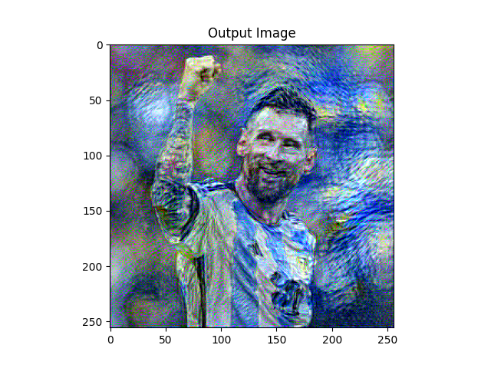
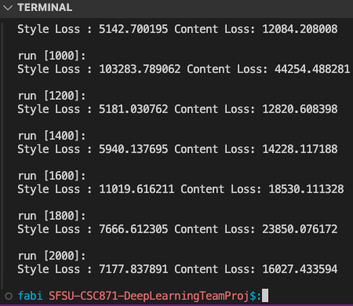
content_loss_weight = 1000
style_loss_weight = 10,000,000
content_layer = 8
style_layers = 2,3,4,5,6
num_steps = 2000

Slide 7
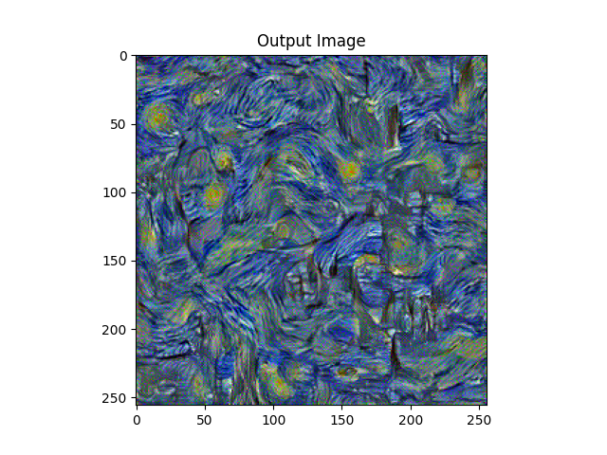
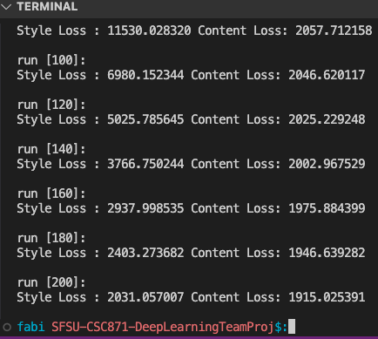
content_loss_weight = 10
style_loss_weight = 100,000,000
content_layer = 8
style_layers = 2,3,4,5,6
num_steps = 200

Slide 8
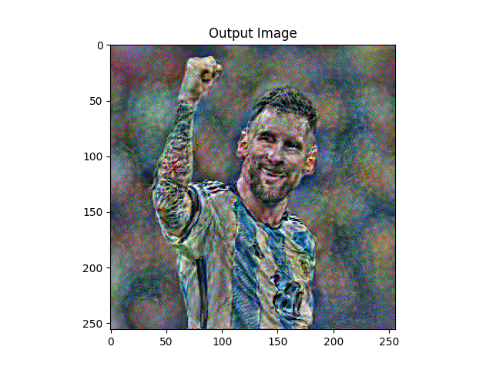
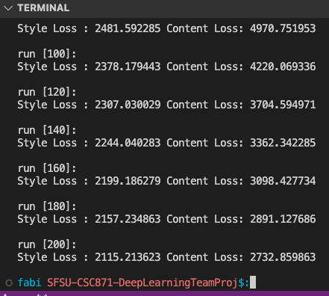
content_loss_weight = 1000
style_loss_weight = 100,000
content_layer = 8
style_layers = 2,3,4,5,6
num_steps = 200

Slide 9
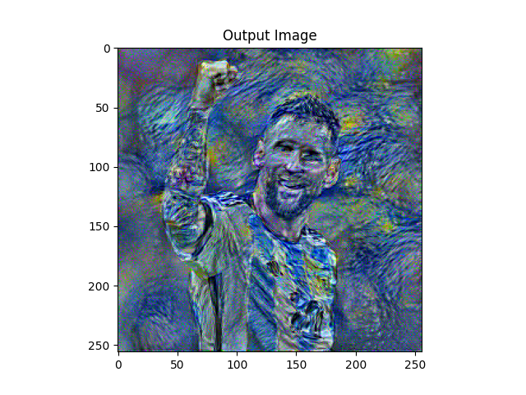
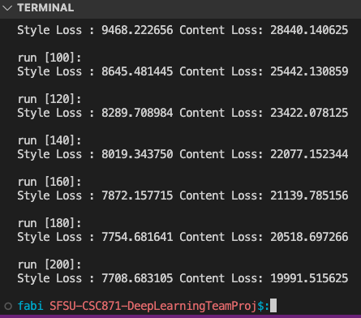
content_loss_weight = 1000
style_loss_weight = 10,000,000
content_layer = 8
style_layers = 2,3,4,5,6
num_steps = 200

Slide 10
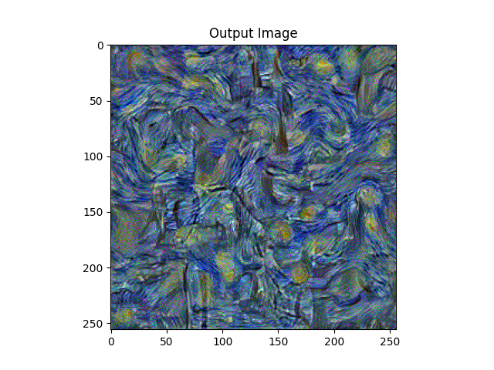
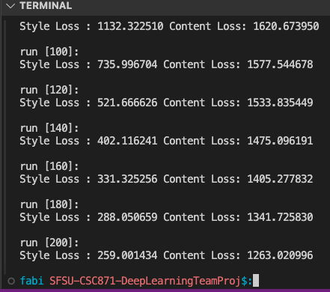
content_loss_weight = 1000
style_loss_weight = 10,000,000
content_layer = 1
style_layers = 2,3,4,5,6
num_steps = 200

Slide 11
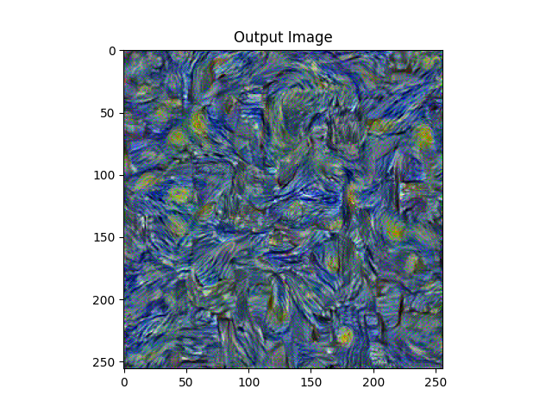
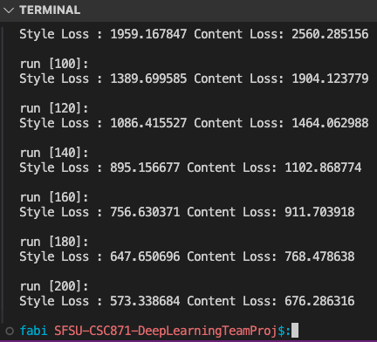
content_loss_weight = 1000
style_loss_weight = 10,000,000
content_layer = 16
style_layers = 2,3,4,5,6
num_steps = 200

Slide 12
content image
Second Option
start image is content
image
style Image

Slide 13
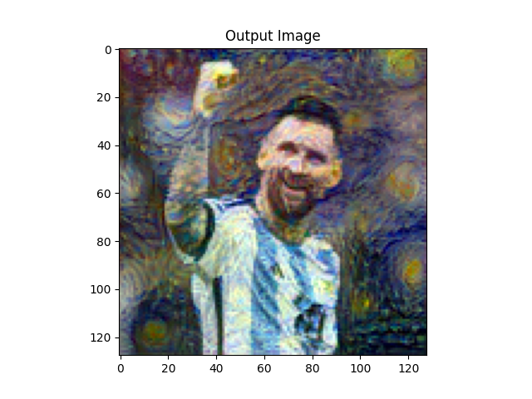
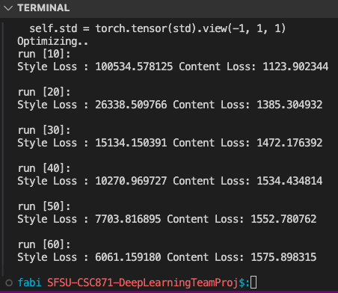
content_loss_weight = 10
style_loss_weight = 10,000,000
content_layer = 8
style_layers = 4,5,6,7,8
num_steps = 50

Slide 14
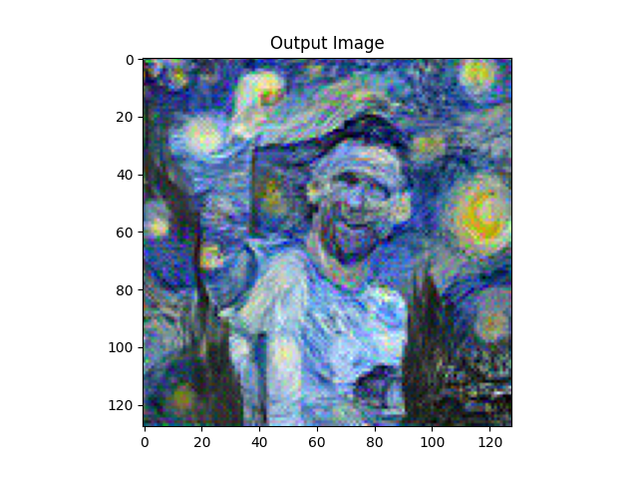
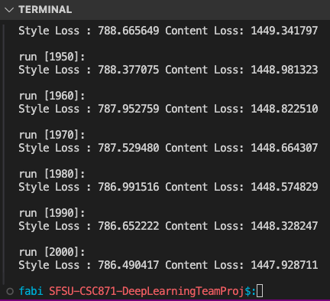
content_loss_weight = 10
style_loss_weight = 10,000,000
content_layer = 8
style_layers = 4,5,6,7,8
num_steps = 2000

Slide 15
Mark part

